Slide 1
MICROCONTROLLER-BASED
TACHOMETER
Microcontroller Lab Project
ECE-D (Vth sem)
Name – Sreemoyee Mukherjee,Shuvi
Roll no.- 17,11
Reg. no.- 160907186,160907124

Slide 2
About the Project
A tachometer is nothing but a simple electronic digital transducer. Normally, it is used for measuring the speed of a rotating shaft. The number of revolutions per minute (rpm) is valuable information for understanding any rotational system. For example, there is an optimum speed for drilling a particular-size hole in a particular metal piece; there is an ideal sanding disk speed that depends on the material being finished.

Slide 3
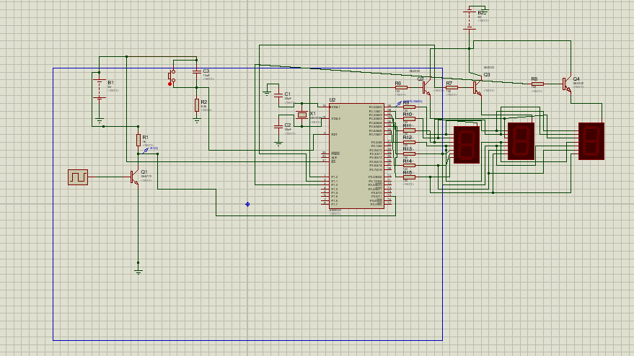
Circuit Diagram

Slide 4
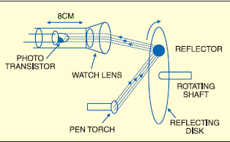
Working
The device will measure the number of rotations of any rotating object and will display it on a 4 digit 7 segment display.
The probe detects the change in reflected light from the rotating object.
the signal is processed to measure the number of rotations.
Each time the tape spins past the probe, the momentary increase in reflected light is detected by the phototransistor.
The suitable arrangement for photoresister is:

Slide 5
Components used:
8051(AT89C51)
Low-voltage, high-performance CMOS 8-bit microcontroller with 2KB of flash programmable and erasable read-only memory. The device is manufactured using Microchip high-density nonvolatile memory technology and is compatible with the industry-standard MCS-51 instruction set. This versatile 8-bit CPU with flash provides a highly flexible and cost-effective solution for many embedded control applications.

Slide 6
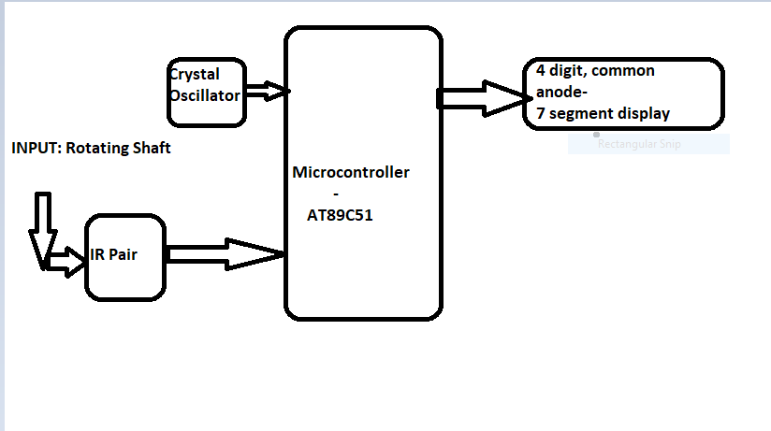
FLOWCHART

Slide 7
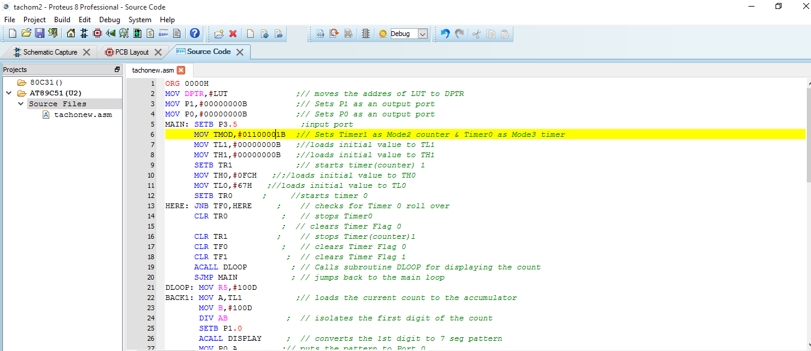
Code:

Slide 8
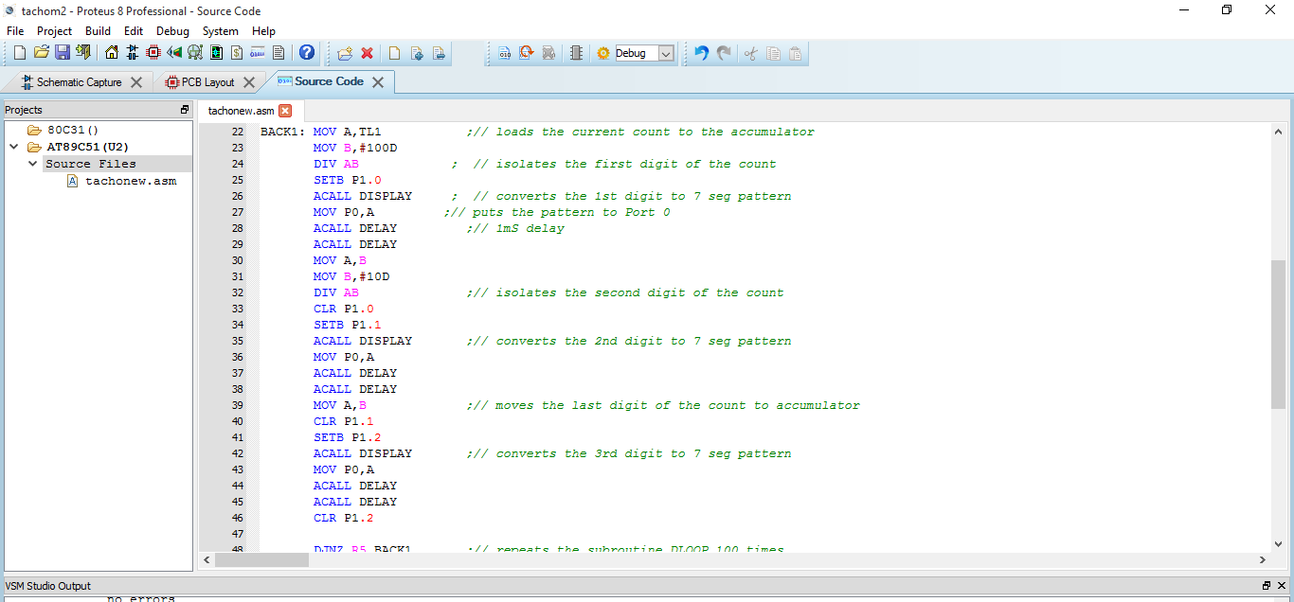

Slide 9
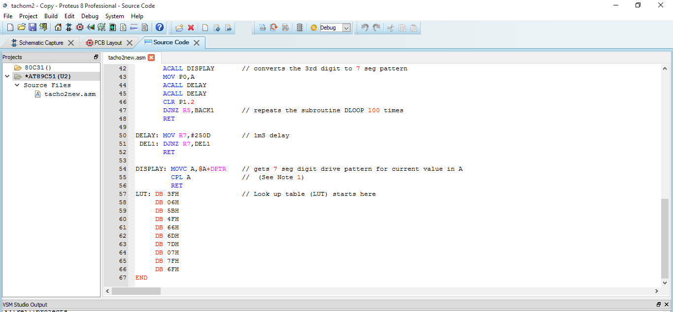

Slide 10
Components Required summarised
IC CA3140
8051(AT89C2051)
ULN2003
LT4F1
7-segment display
Phototransistor pair(2N2222)
LED
Resistors, capacitors
Diode 1N4007
6V Battery

